Slide 1


What is Reproducibility and why it matters for you
Coding in Public Workshop
2024
Copyright © 2021. Created by Computational Social Science Training Team, UK Data Service.

Slide 2
Table of Contents
What is reproducibility?
Why you should care
Special considerations for social and data sciences
Q&A
Break out groups #1

Slide 3
What is reproducibility

Slide 4
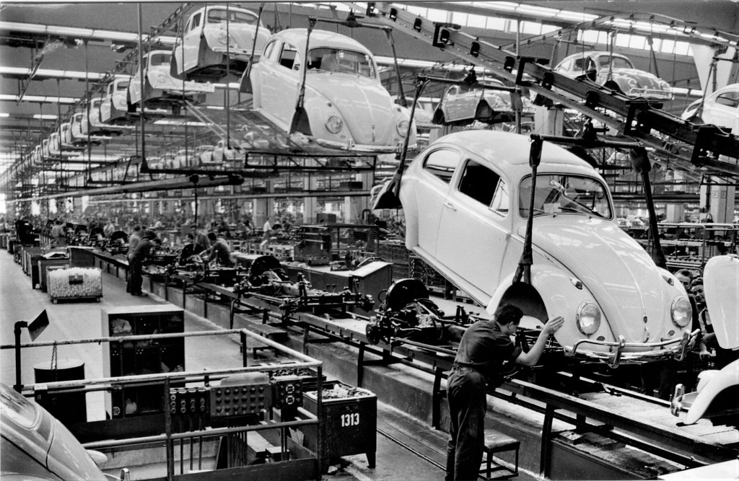
What is reproducibility?
Getting “the same” results
This Photo by Unknown Author is licensed under CC BY
Notes:
There are no true hard and fast rules for terminology, but what I have found most often comes down to whether you are talking about
repeating the process from data collection with or without experimentation or
Taking someone else’s data set and making sure there is no funny business in the stats or weird conclusions
Others may use these terms differently, may use other terms, etc.
To be clear, I am using “reproducibility” as a general term to mean one or more steps used to produce published research

Slide 5
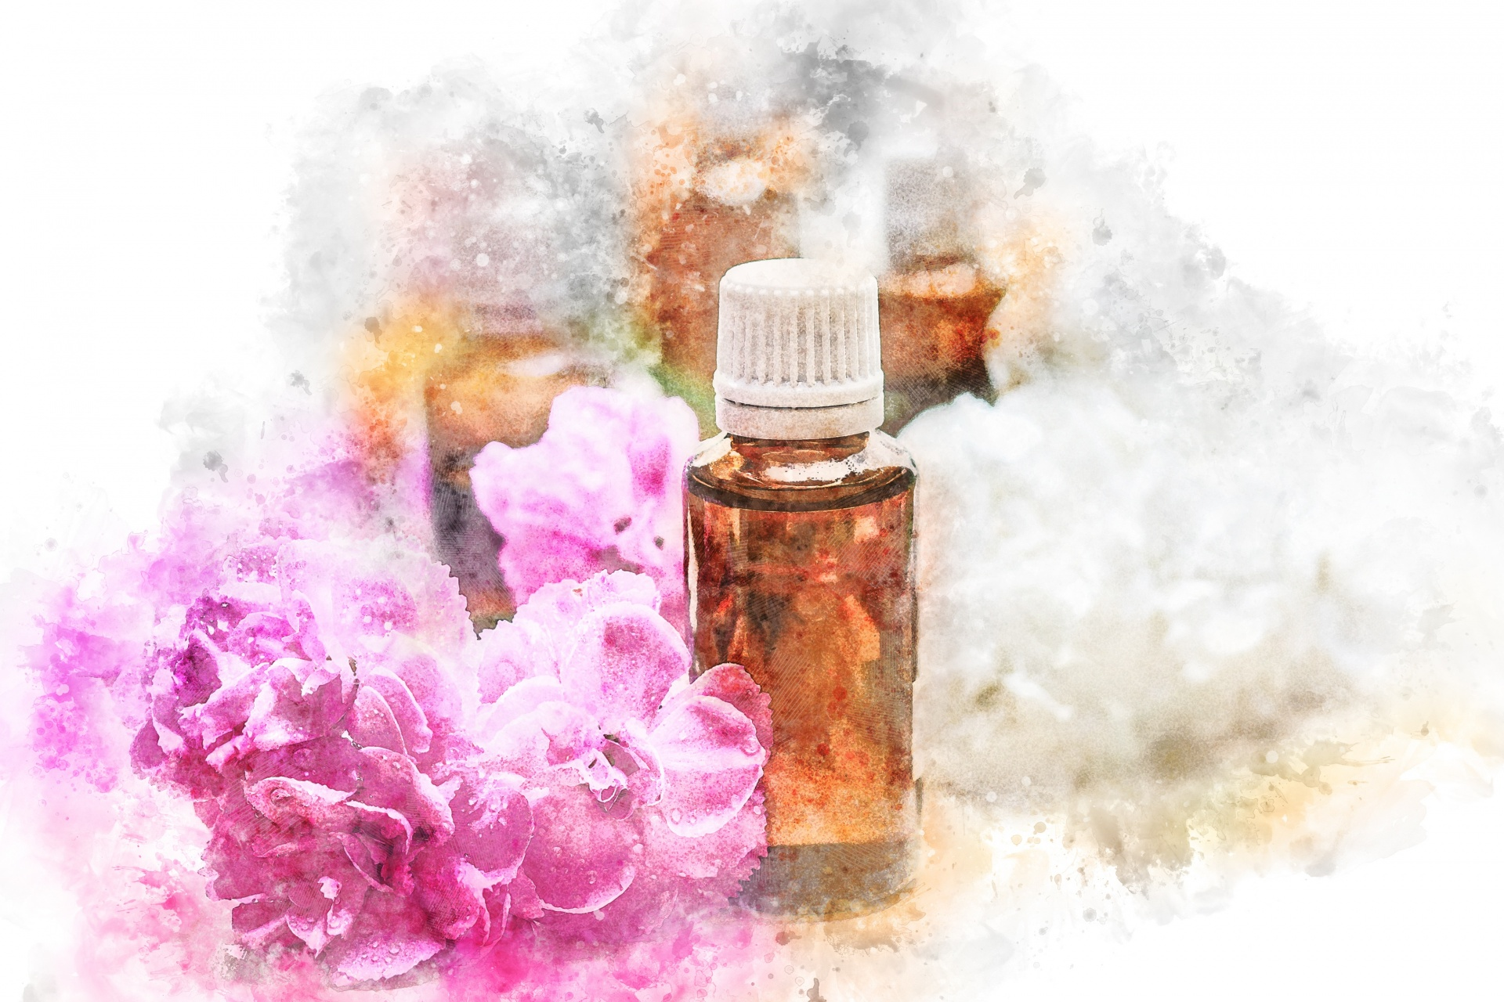
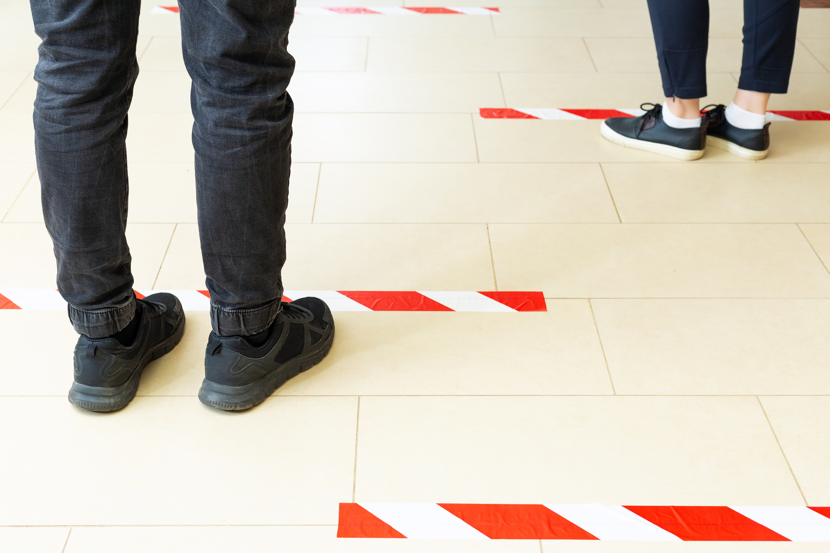
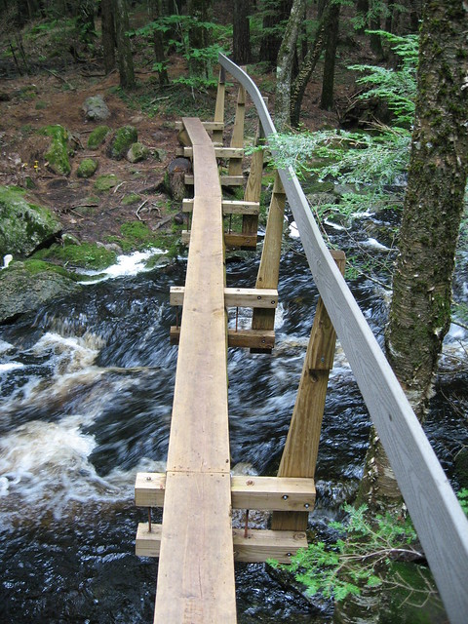
Reproducibility in brief
Essential part of the scientific method
Maybe repeat an entire scientific work
Maybe narrowly recreate an analysis
This Photo by Unknown Author is licensed under CC BY-SA-NC
Notes:
Puts the “peer” into empirical.
Could be about step-by-step recreation of an entire scientific output as closely as possible
Could be about taking the same data and narrowly rerunning the analysis, potentially with one or more minor changes, to see how robust the analysis was
Could be anywhere in between!

Slide 6
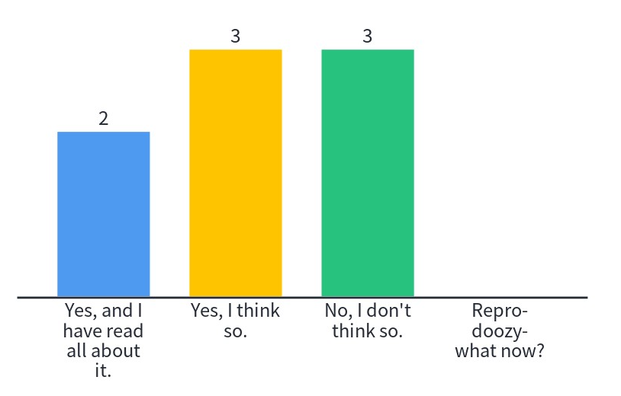
Have you heard of the “reproducibility crisis”?

Slide 7
The reproducibility crisis!
Social Psychology and “repligate” (Chambers 2014)
More than 70% of researchers have tried and failed to reproduce another scientist's experiments (Baker 2016, Chambers 2014)
More than 50% have failed to reproduce their own experiments (Baker 2016, Chambers 2014)
Few published their efforts to reproduce (especially “failed” ones) (Baker 2016,Chambers 2014)
Few contacted the original researchers with questions about reproduction fails (Baker 2016,Chambers 2014)
New activism/movements about open science, ‘metascience’, etc.
Notes:
A few researchers were talking about reproducibility in the 60’s and 70’s. It got a bit bigger in the 90’s and then blew up in the late 00’s before Social Psychology set out to reproduce influential discoveries as far back as 1950’s. Shocking lack of success.
Digging into it revealed a few deeper issues and problems.
Some original researchers seemed to embrace it as part of the scientific method (but not all).

Slide 8
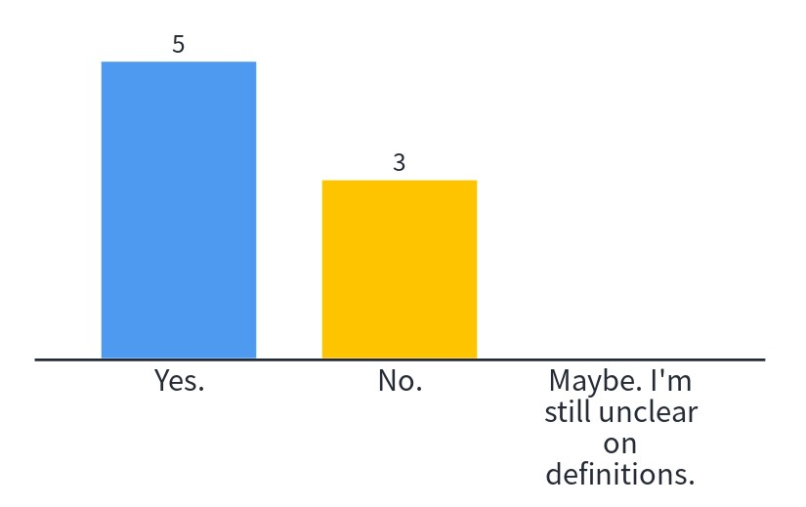
Have you tried to reproduce a research project?

Slide 9
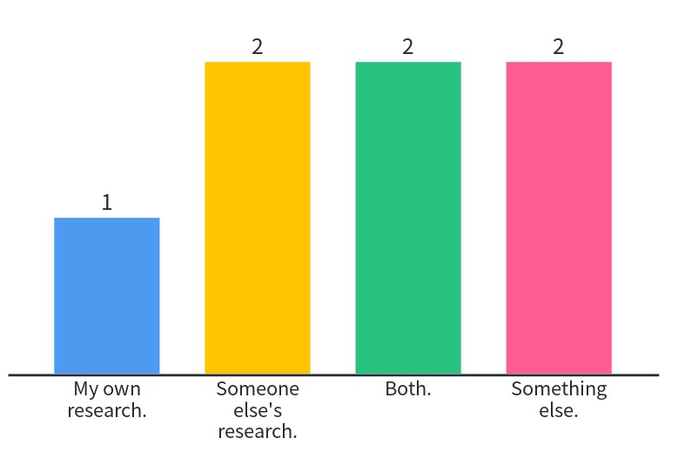
What did you try/want to reproduce?

Slide 10
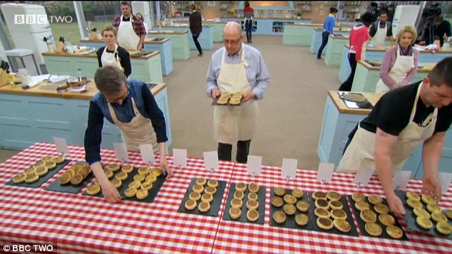
Reproducible research is like a good recipe
NOT like the technical challenge on Great British Bake Off

Slide 11
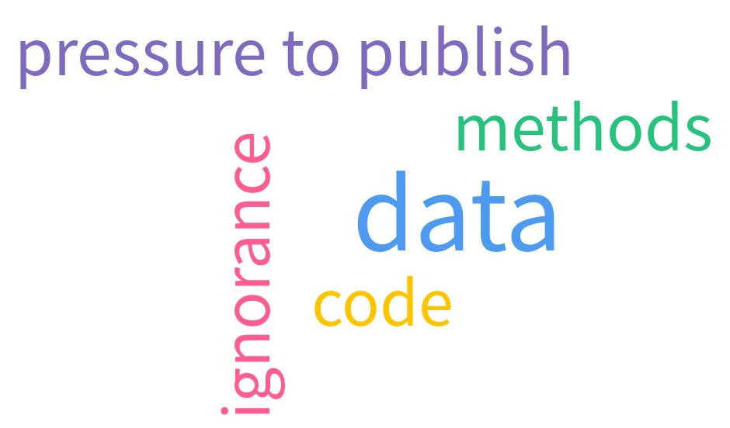
What do you think is driving this crisis?

Slide 12
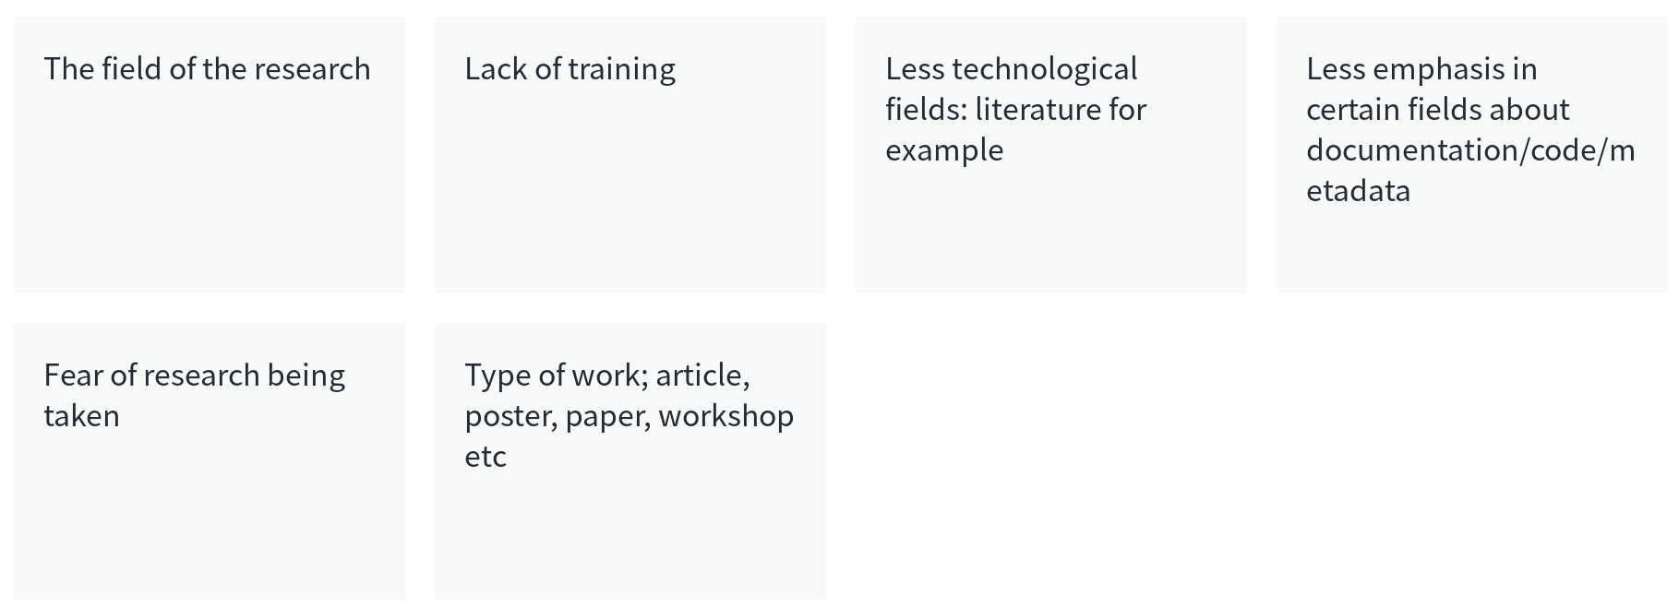
Does the crisis of reproducibility affect some researchers more than others?

Slide 13
Why you should care

Slide 14
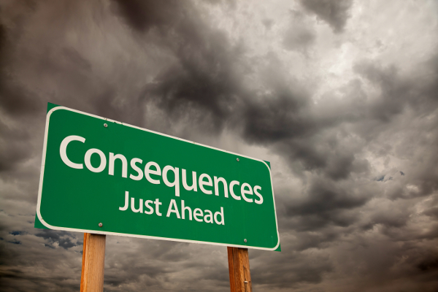
Consequences for society
Inappropriate take up e.g. pro-austerity “proof” (Alesina 2010, Krugman 2013, Devries 2011)
Wasted time, money, research efficiency, etc. (Freedman 2015, Mack 2014, Roesch 2020)
Loss of trust (Chambers 2014, Freedman 2015, Peterson 2021)
This Photo by Unknown Author is licensed under CC BY-NC-ND
Notes:
Not everything is “true” – seek more support before making big decisions. Especially if the “truth” is appealing, ideologically aligned, simple, reducible, single solutions, etc.
Science is a team game, and benefits from wider participation and interaction. Trying to shut that down is a problem and a waste.
Loss of trust → dismissing psychology, people that get therapy, woo-woo solutions, etc.

Slide 15
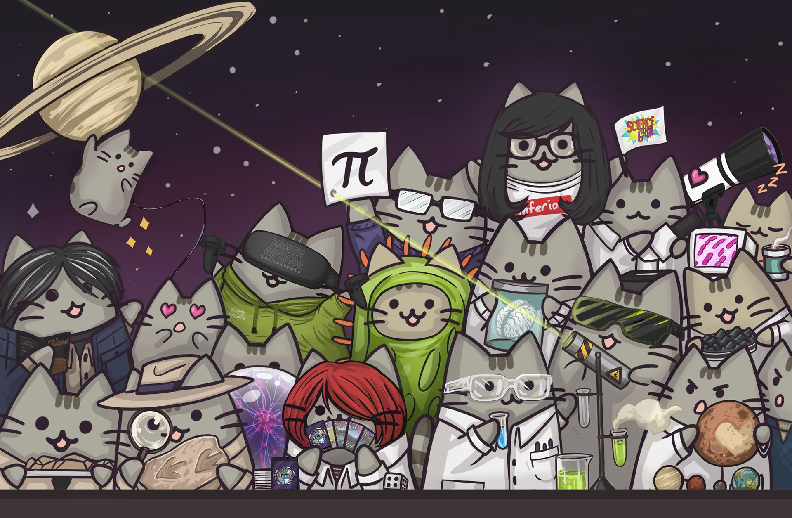
Consequences for science and scientists
Wasted time, money, research efficiency, etc. (Freedman 2015)
Distorted research culture (Baker 2016, Freedman 2015,Roesch 2020)
Loss of trust (Chambers 2014, Freedman 2015)
Reputational damage (Chambers 2014)
https://kellystanford.co.uk/science-pusheen
Notes:
Many of the same consequences for wider society apply more specifically to scientists or academic institutions.
Time, money, effort and potential are wasted.
Research cultures are distorted as institutions try to achieve impossible things/try to hide what they did.
We end up with Micheal Gove saying people don’t want experts.
People fight dirty when they are down.
All of this is not easy. It is not comfortable to tell the emperor he has no clothes. It is not what many of us were trained to do.

Slide 16
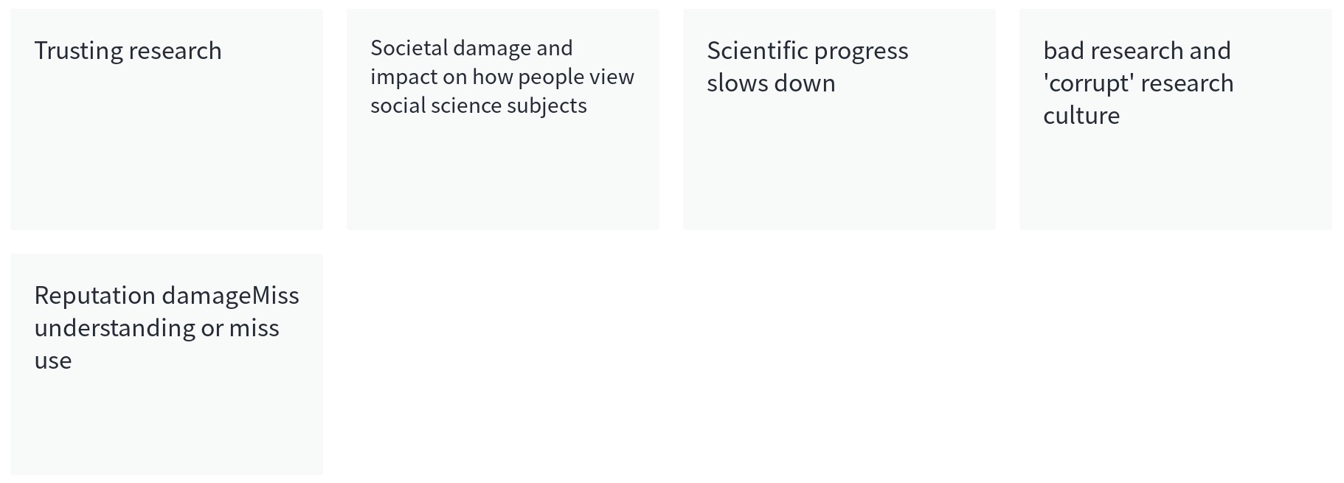
What impacts matter to you most?

Slide 17
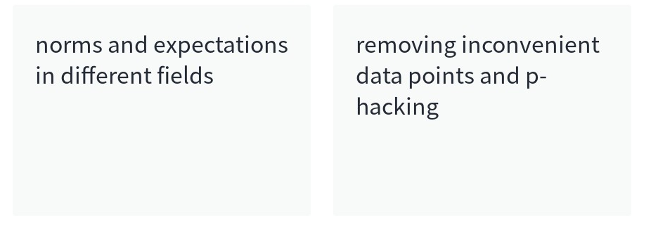
Do these impacts affect some researchers more than others?

Slide 18
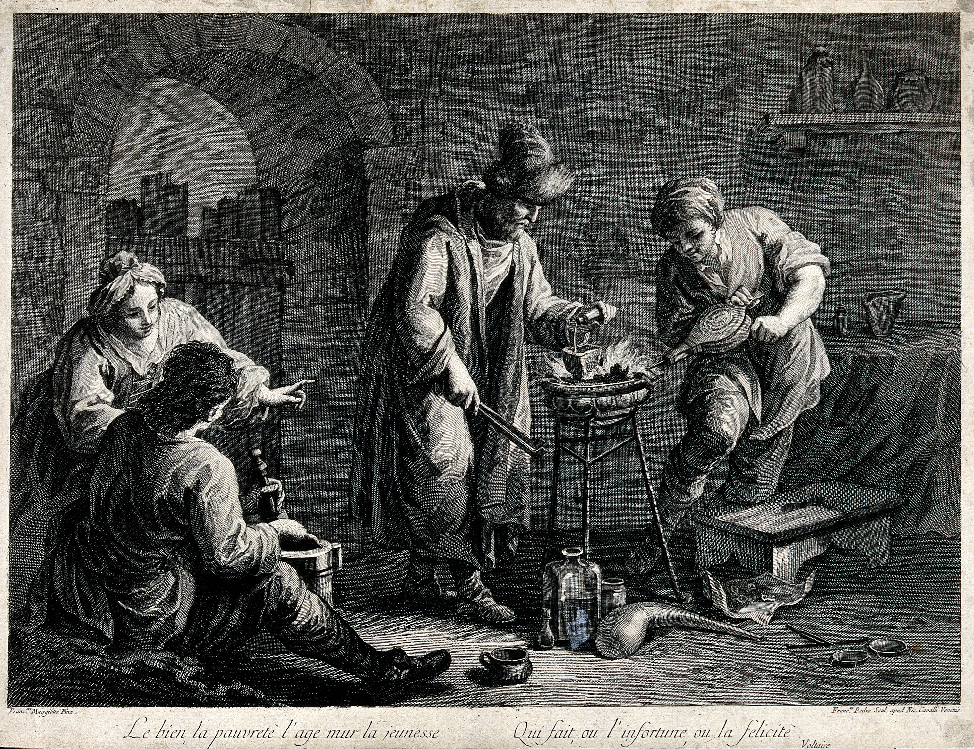

Longstanding problems of research culture
Share or protect knowledge?
(Kasmire 2021)
Who gets the credit?
This Photo by Unknown Author is licensed under CC BY-SA-NC
This Photo by Unknown Author is licensed under CC BY
Notes:
Training, examples, mentorship, experience of working with research methods, etc.
Hierarchical or flat structures? Who has power? Who is respected? Who can speak up? Etc.
Publish or perish? Pressure to be new? Flashy? controversial? Singe author? Triple A star gold plated journals?
Do the journals have checklists or standards for what must be included? How strict are the methods section requirements?
How tight is money? Who sets the budgets and what do they value?
How do people react to post-publication contact? How normal is this? Is there time for real engagement or is everyone rushed off their feet?

Slide 19
Collaboration? Or Competition?
Fear of being scooped is a long-standing problem
Credit is always hard to apportion, especially after things have got out of control
Both need proper documentation!
Notes:
Proper documentation of who will do/did what and when
Clarifies the discovery process in a hard-to-fake way
Fairly supports the researchers who have done the work
Communication is always key to teamwork
Embrace tools/processes to improve documentation/communication

Slide 20
More share/protect problems in research culture
Education
Hiring/promoting
Publishing
Funding
Post-publication engagement
Reputation
Other?
Which can contribute to Questionable Research Practices!
Notes:
Training, examples, mentorship, experience of working with research methods, etc.
Hierarchical or flat structures? Who has power? Who is respected? Who can speak up? Etc.
Publish or perish? Pressure to be new? Flashy? controversial? Singe author? Triple A star gold plated journals?
Do the journals have checklists or standards for what must be included? How strict are the methods section requirements?
How tight is money? Who sets the budgets and what do they value?
How do people react to post-publication contact? How normal is this? Is there time for real engagement or is everyone rushed off their feet?

Slide 21
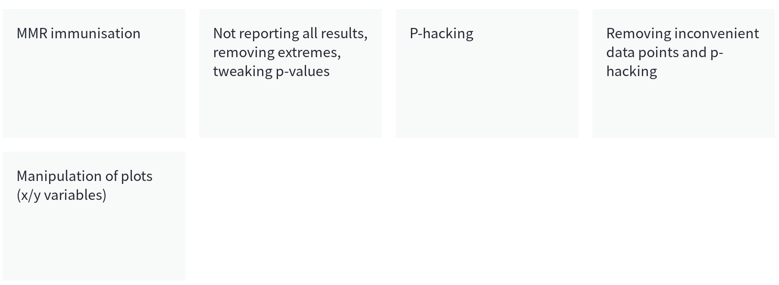
What questionable research practices or “soft fraud” have you seen/done/heard about?
Notes:
Cherry picking data
Refusing to share data
Minimum acceptable detail in methods section
Cognitive bias

Slide 22
Avoid the questionable, be reproducible
Good “research recipes” should include:
Data (raw to research-ready, details of acquisition, representativeness, etc.)
Tools (materials, software, packages, versions, etc.)
Decisions made (in cleaning, processing, recoding, etc.)
Analysis (order of operations, code where possible, graphs and numbers, etc.)
Results (clear and as objective as possible)
Access (to data, code, notebooks, recordings, transcripts, etc.) IF POSSIBLE

Slide 23
Reproducible research recipes are not easy
They take time, effort, and knowledge which means…
Reproducible research recipes can feel very vulnerable.

Slide 24
Vulnerability
Showing your work leaves you open to:
Criticism about your effort or knowledge (not all valid)
Competition (not always a bad thing)
Requests that take time (not always worthwhile)
SPAM (the modern age)

Slide 25
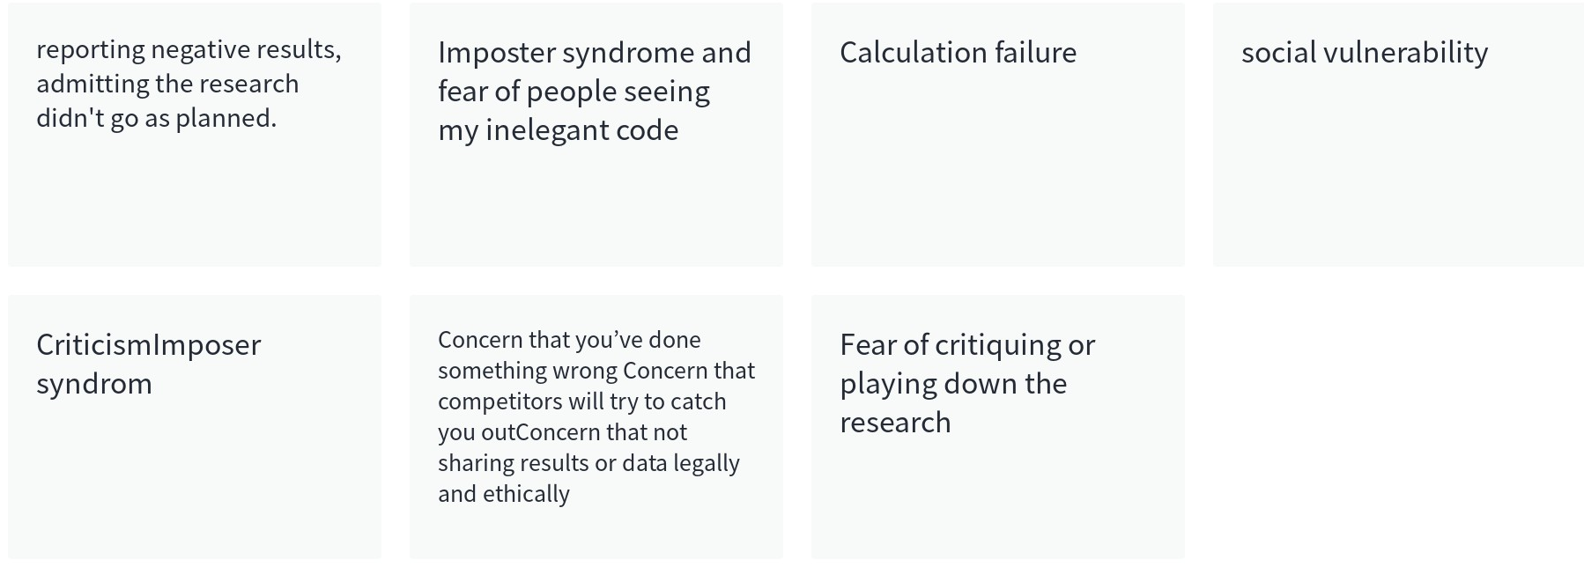
What makes researchers feel (especially) vulnerable?

Slide 26
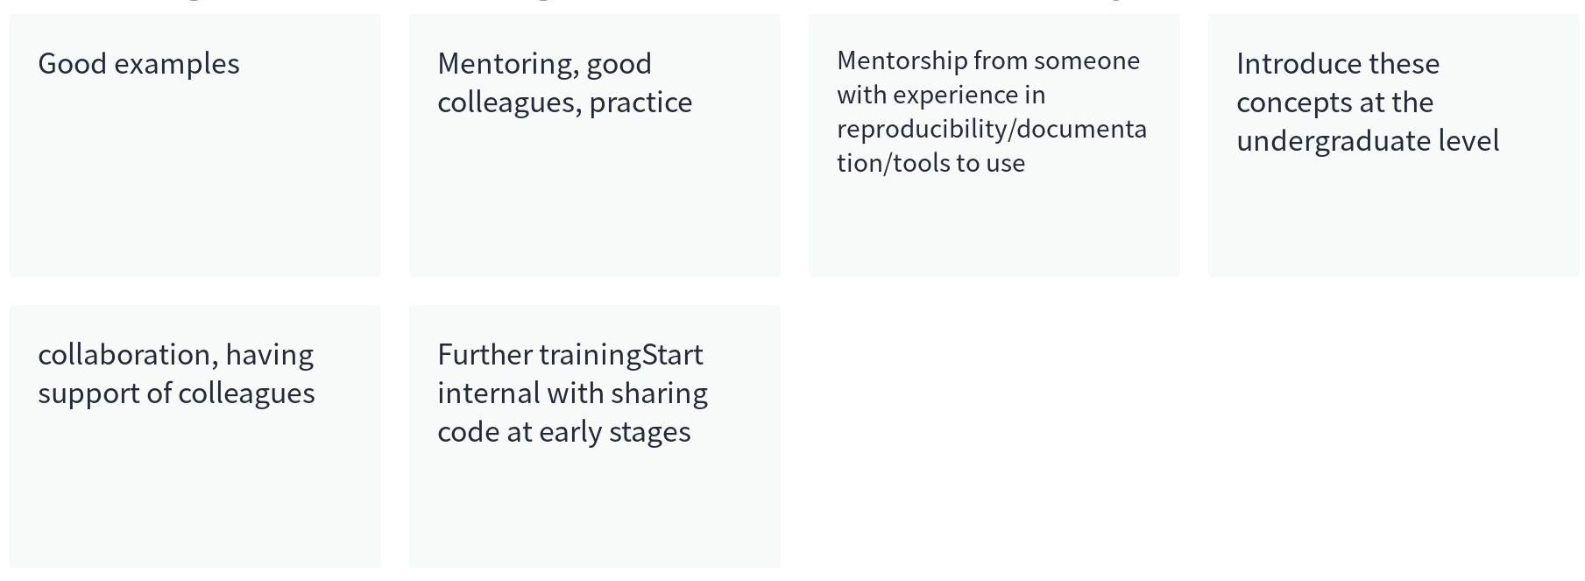
What might reduce researcher vulnerability?

Slide 27
Special considerations for social and data sciences

Slide 28
Reaction #1 – It’s just a misunderstanding
“Crisis” is overblown, reactions may be ham-fisted
(Peterson 2021)
Reproduction efforts should require permission/collaboration of original author
(Chambers 2014)
Notes:
Maybe we need to tighten up a few requirements, but aren’t scientists a trustworthy bunch on the whole?
At the same time
Science should abandon the concept that any old scientist should just be able to jump in and reproduce something – they should instead seek to contact/collaborate with the original author.
These are slightly at odds – either we trust scientists to get be doing the right thing for the most part or we don’t trust scientists and they need to be given permission to science.

Slide 29
Reaction #2 – Revolution now!
Make “soft” sciences more like “hard” sciences
(Chambers 2014)
Market based solutions e.g. incentives, apps, journals, etc.
(Roesch 2020)
Notes:
After all, hard sciences have a culture of lab notebooks, meticulous documentation, standardised equipment, etc. and have histories of pre-prints, accessible data repositories, etc.
Soft sciences need to get on board!
Or, people are fundamentally lazy/inept and need incentives to make their own interests align with wider community interests.
Also at odds a bit. If we need market-based solutions, why are “Hard” sciences better at it than soft ones? Alternatively, do we need different incentives for different types of research?

Slide 30
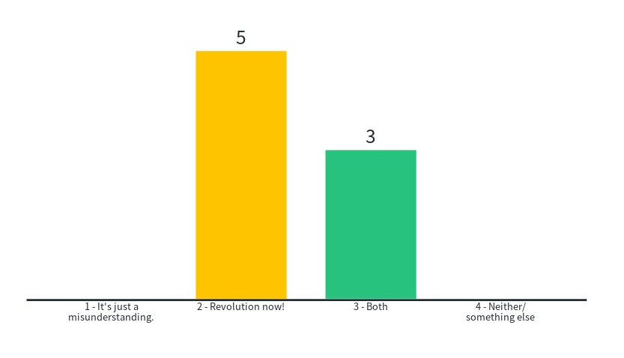
Which of these reactions makes more sense?

Slide 31
All the interesting stuff in “soft” sciences is…
Not usually easy to measure, at least directly
Can be VERY difficult to formalise
Don’t often have agreed on definitions
Rely on subjective judgements/scores
The results cannot always be meaningfully separated from the context of the research

Slide 32
Still, even in “soft sciences”
But! More evidence is more persuasive!
“Soft” science research is unlikely to have a big effect if it isn’t well supported and open to scrutiny.

Slide 33
Problems with reactions #1 and #2
Hard sciences are not exempt
(Baker 2016, Freedman 2015, Roesch 2020)
Efforts to improve show some improvement…
But only in the most high-impact journals (Ball 2018)
Nobody like to be forced to change, especially through seemingly
irrelevant “solutions” imposed from above (Peterson 2021)

Slide 34
Multiple, mutually reinforcing solutions for big change
Better training, mentorship, experience
Self/buddy replication, replication journals
Consolidate or standardise methods/materials/protocols
More time, rewards, support, incentives
Change publishing practice
Share data, code, etc.
Attitude change
Field-generated or field-specific solutions
Chambers 2014, Mack 2014, Freedman 2015, Baker 2016, Ball 2018, Roesch 2020, Peterson 2021
Notes:
Training in stats, research team protocol, etc.
Publishing changes = pre-registration, publishing negative results, checklists for minimum methods standards, action by journals/conferences as well as individual researchers, journals just for replications, journals just for negative results, etc.
Many of these are expensive, time consuming, and difficult because they require both collaboration and honesty.
Not all incentives are well taken up so something else is going on
Ideally, these become habit

Slide 35
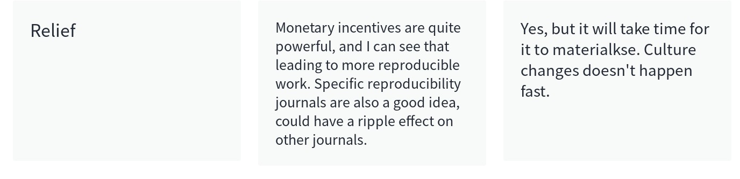
Do these solutions make the vulnerability issues better or worse?

Slide 36
Redefine the problem and goal
100% reproducibility is not the goal
Go cautiously
Embrace complexity
Embrace collaboration and/or competition
Strive for open science
Automate the boring stuff (Sweigart 2019)
Recognise and deal with vulnerability
Notes:
Not all good science is totally reproducible but greater transparency is still valuable
Don’t assume results are “true” – always look for reproducibility potential
Don’t look for simple, reducible, single solutions
Science is a team game, don’t try to be the “lone genious” jealously protecting ideas from idea stealers or holding onto first mover status by not allowing other movers
It is not easy. It is not comfortable. It is not what many of us were trained to do.
It gets easier if we change the climate, recognise the unevenly distributed challenges and work to make it better for everyone

Slide 37
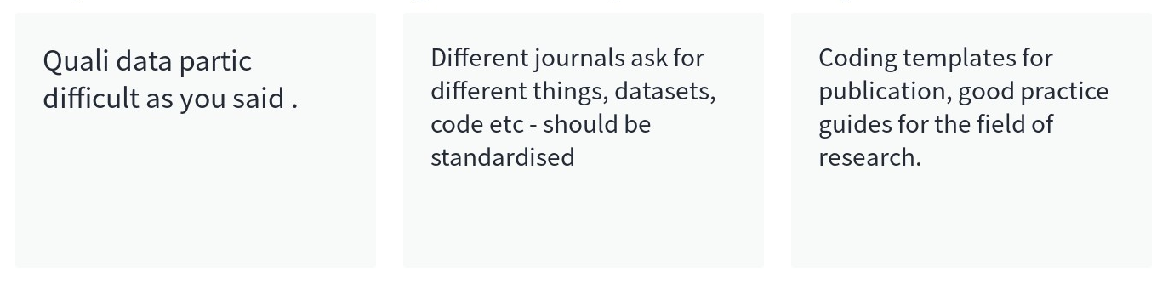
Any additional thoughts on reproducibility or vulnerability in “soft” sciences?
Notes:
Short answer/discussion about how their experiences.

Slide 38
References
Alesina, A. a. A., Silvia (2010). "Large changes in fiscal policy: taxes versus spending." Tax policy and the economy 24(1): 35--68
Baker, M. (2016). "1,500 scientists lift the lid on reproducibility." Nature 533: 452-454.
Ball, P. (2018). "High-profile journals put to reproducibility test." Nature.
Chambers, C. (2014). Physics envy: Do ‘hard’ sciences hold the solution to the replication crisis in psychology? The Guardian.
Devries, P. a. G., Jaime and Leigh, Daniel and Pescatori, Andrea}, (2011). "A new action-based dataset of fiscal consolidation." IMF working paper.
Freedman, L. P. a. C., Iain M. and Simcoe, Timothy S. (2015). "The economics of reproducibility in preclinical research." PLoS biology 13(6).
Kasmire, J. (2021). "Managing balance: Pursuit of equilibrium permeates the history of science and influences contemporary investigations." Humanistic Management Journal 6(1): 133--146.
Krugman, P. (2013). "How the case for austerity has crumbled." The New York Review of Books 6.
Mack, C. A. (2014). "In Praise of the Null Result." Journal of Micro/Nanolithography, MEMS, and MOEMS 13(3).
Peterson, D. (2021). "The replication crisis won't be solved with broad brushstrokes." Nature 594(7862): 151--151
Roesch, E. a. R., Nicolas P (2020). " New journal for reproduction and replication results." Nature 581(7806).
Sweigart, A. (2019). automate the boring stuff with Python: practical programming for total beginners, No Starch Press.

Slide 39
Q&A

Slide 40
Break out #1
Notes:
Participants introduce themselves, share ideas on the topic, basic icebreaker stuff to make participants more comfortable rather than to really generate much serious discussion.

